Slide 1
Chatbot Implementation in Customer Service Industry
By –
Likhita Chandana Adabala
Naveen Kumar Reddy Desireddygari

Slide 2

Contents
INTRODUCTION
DATA COLLECTION
DATA PREPROCESSING
MODEL INTRODUCTION
EXPERIEMENTS/ RESULTS

Slide 3

Introduction -
The goal of this project is to develop conversational chatbots that can simulate human-like conversations using Natural Language Processing (NLP) techniques. The chatbots will function as virtual personal assistants for customers seeking information on Yale's graduate programs.
To achieve this, we will use a T5 tokenizer model that is trained on a custom dataset containing inquiries about Yale's graduate programs. The chatbots will be capable of engaging in conversations with users and answering queries related to various graduate programs offered at Yale University.

Slide 4

DATA COLLECTION
In this project, we have developed a conversational chatbot that can answer user queries about Yale's graduate programs using information gathered from the university's official website. The chatbot is capable of engaging in both general conversations and program-specific inquiries related to various fields of study, including Arts, Humanities, Environmental Science, and Public Health.
The dataset used to train the chatbot contains 131 samples, which includes information about the highlights of the university, as well as the application process and requirements for each program. The dataset starts with general conversations, and then progresses to specific inquiries about Yale's graduate programs, all of which were sourced from the official website of the university.

Slide 5
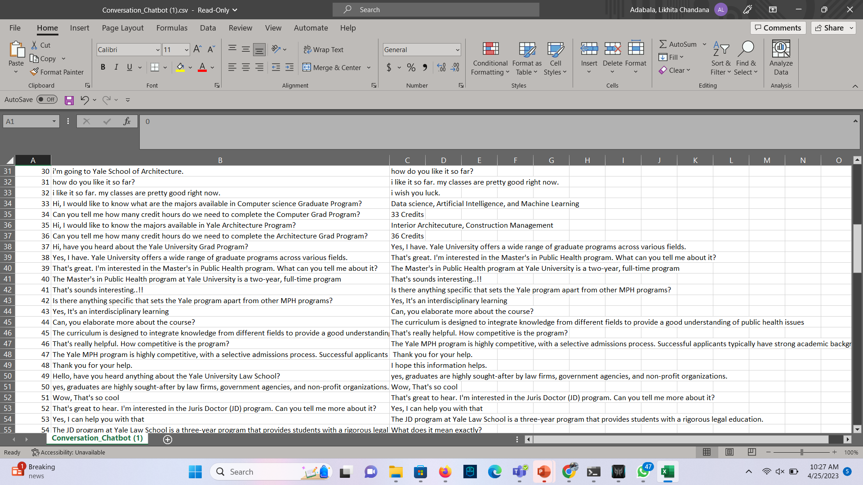
SAMPLE DATA
Data Set Link: https://drive.google.com/drive/folders/1lxE7Z2uJlQCwFKnfV6oHNgt0CsCVlF3?usp=share_lin k

Slide 6
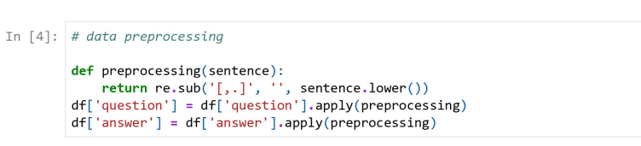
Data Preprocessing
preprocessing() function performs the following processes on a phrase after receiving it as input:
Using the .lower() function, every character is converted into lowercase.
Using the regular phrase '[,.]', it eliminates all commas and periods.
The text data in the question-and-answer columns of the pandas Data Frame is cleaned up in the data preparation stage.
It specifically uses the pandas .apply() method to apply the preprocessing procedure to each member of these columns

Slide 7

PRE-TRAINED MODEL INTRODUCTION
(T5 TOKENIZER)

Slide 8
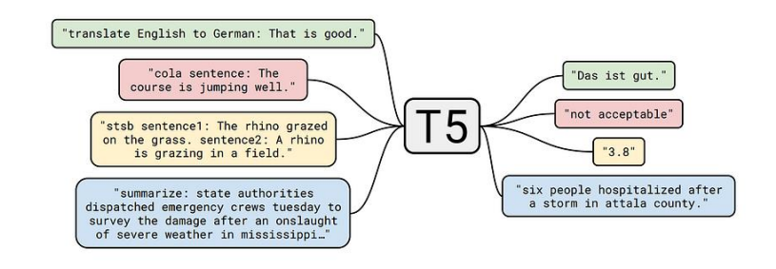
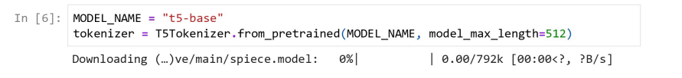
T5 Tokenizer:
T5: Text-to-Text-Transfer-Transformer paradigm suggests reformulating all NLP tasks into a common text-to-text format where the input and output are always text strings. In this case, we have used this model to work on question and answering task.

Slide 9
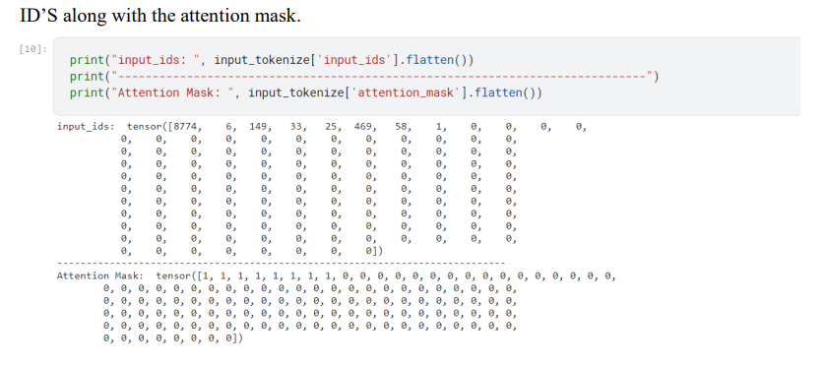
Tokenization
We need to tokenize the input sequence that is the question in our case and produce an attention mask along with the tokenized input id’s.
We use the attention mask to generate to check whether we require those tokens or not.
The above picture shows the tensors representing the Input

Slide 10

PYTORCH LIGHTENING- FOR TRAINING AND VALIDATION
To build a T5-based model with PyTorch Lightning, you first need to define a Lightning Module
class. This class represents the model architecture and contains all the necessary methods for
training, validation, and inference.
Within the init method of the Lightning Module class, you can define the model architecture
using the T5 model from the Transformers library. You can also define any other
hyperparameters for the model, such as the learning rate, number of epochs, and batch size

Slide 11
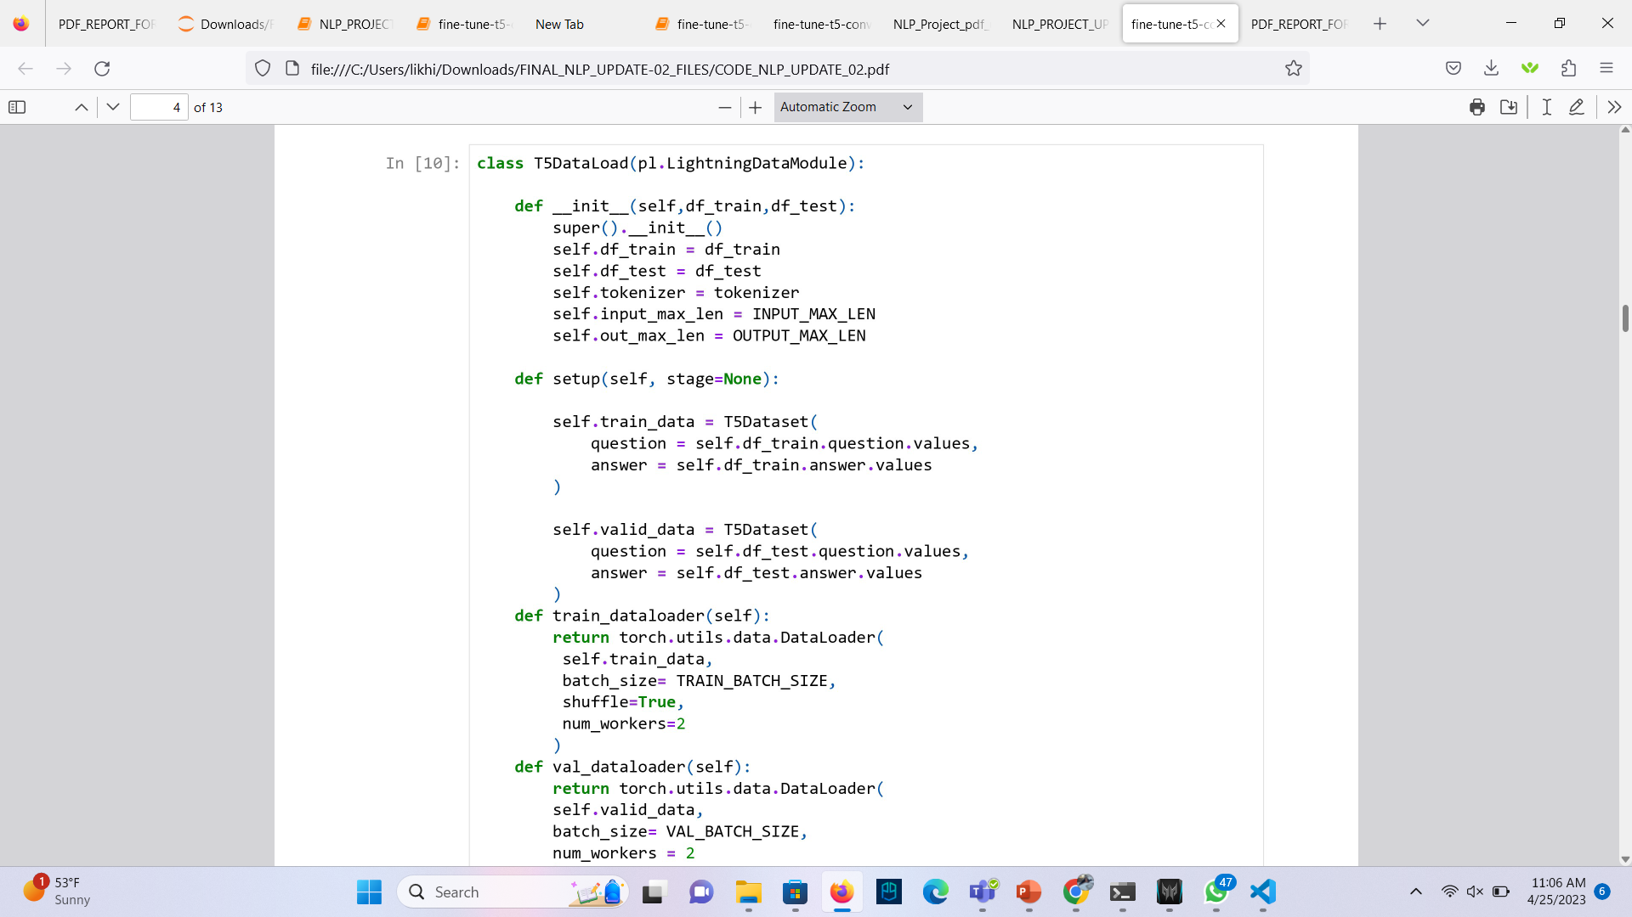
DATALOADER CLASS USING PYTORCH LIGHTNING

Slide 12
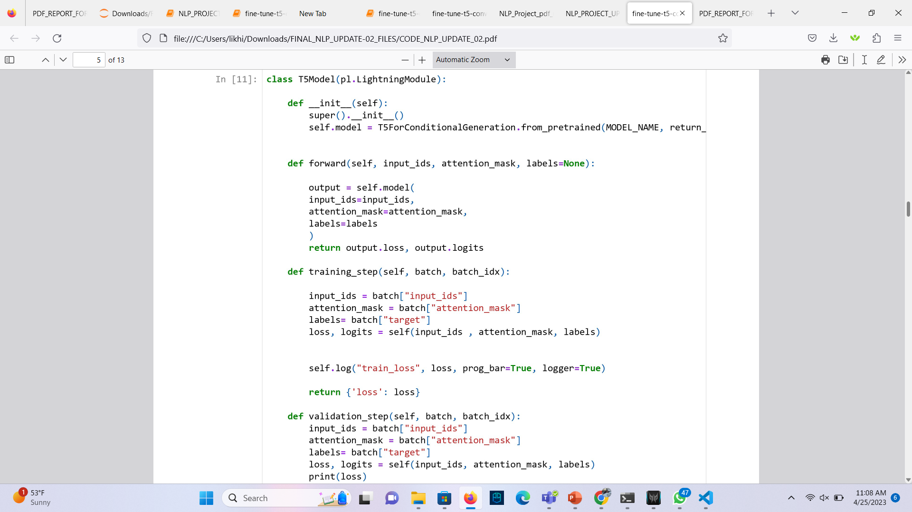
T5 MODEL CLASS

Slide 13
ADAMW OPTIMIZER
he AdamW optimizer is commonly used in natural language processing tasks and has been shown to be effective in training large-scale language models. In this case we have used “The AdamW optimizer” is a variant of the Adam optimizer that includes weight decay regularization, which helps to prevent overfitting during training. The optimizer is created with a learning rate of 0.0001, which determines the step size used to update the weights.

Slide 14
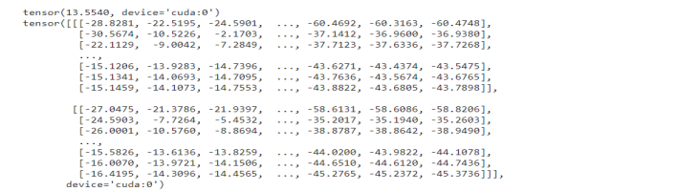
Performance metrics(Loss)
The loss determined b a model during training or assessment is represented by the first value, tensor (13.5540, device='cuda:0’).
It is a scalar value that measures how successfully the model completes a certain job. In this instance, it appears to be a Tensor object with a value of 13.5540 that is kept in GPU memory
The model has not yet learnt to correctly categorize the inputs, as shown by the negative values in the logits tensor. Because of the limited data set we have taken
The loss should go down as the model is trained more, and the logits should grow more precise and confident.

Slide 15
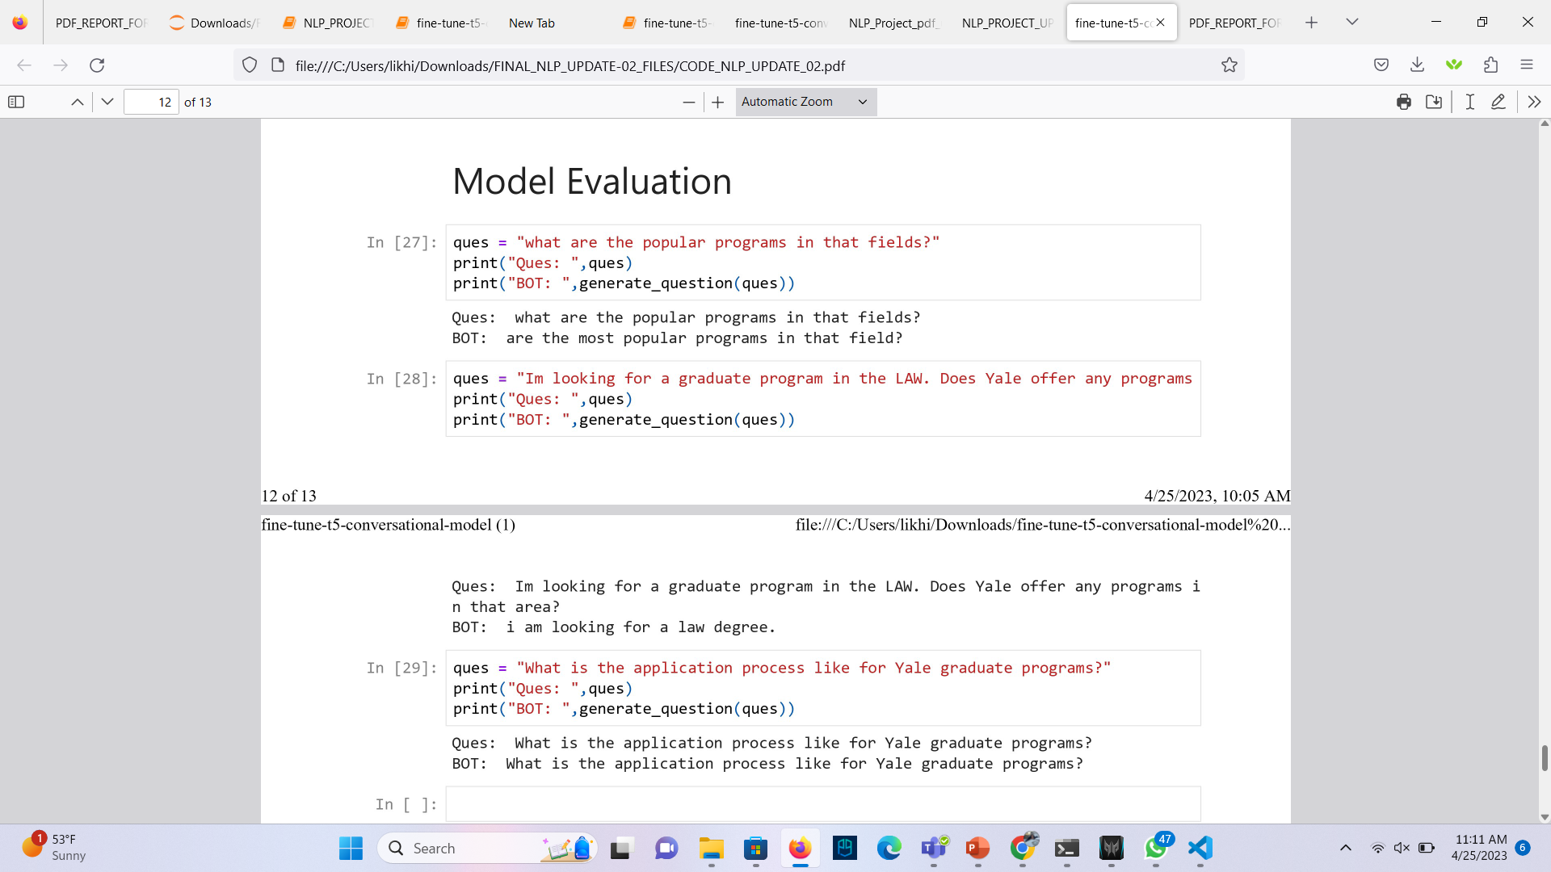
Model Evaluation

Slide 16
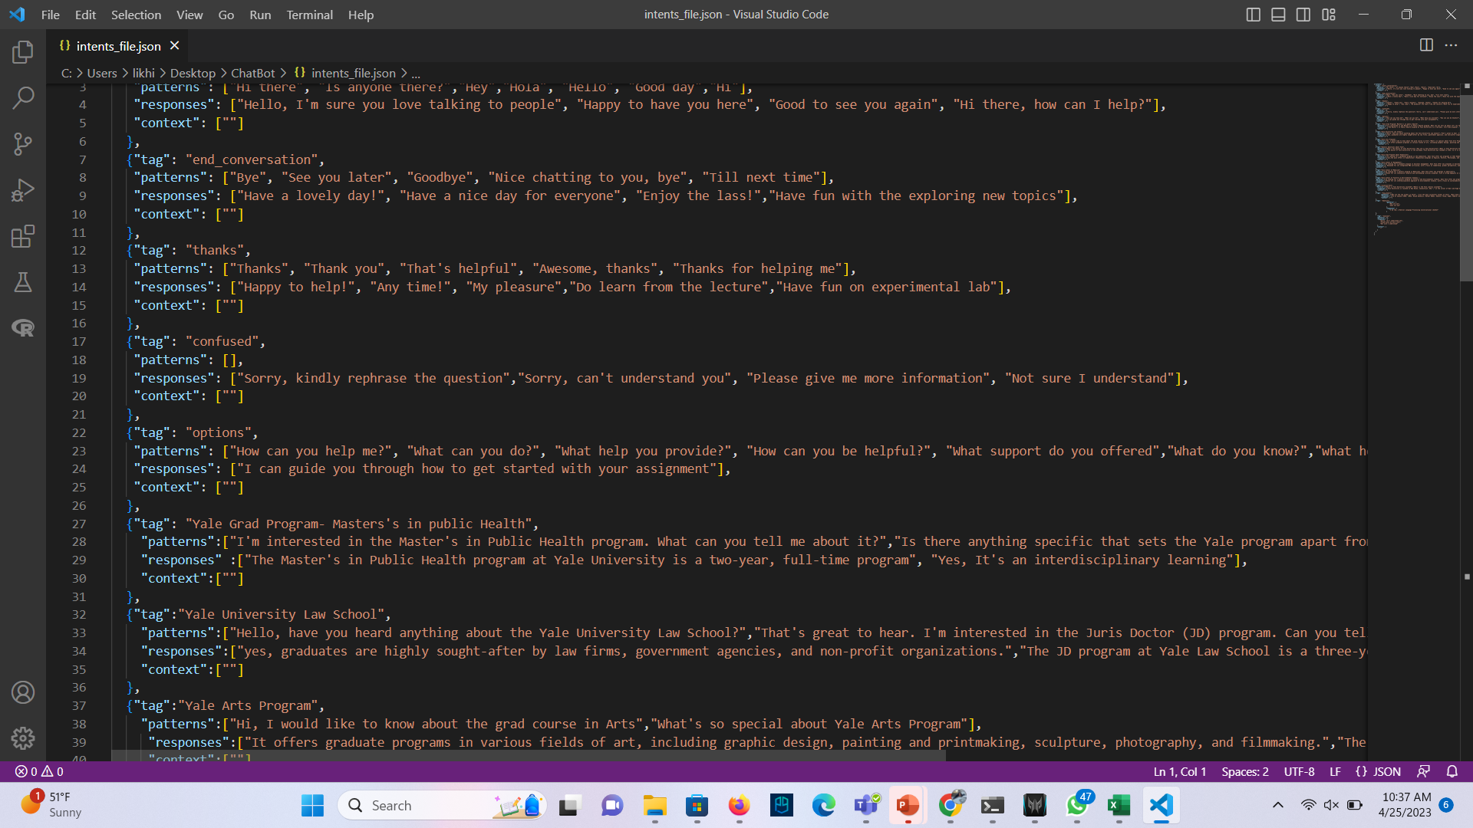
EXPERIMENTS ON DATASET
We ended up making two different datasets for this project :
Json format with intents and responses. Instead we have chosen the csv file because of the limitation of context we have taken. This works well if the context is huge. So, we again ended up with the same CSV FILE.
DATASET LINK : https://drive.google.com/file/d/1lh70okRxsHFyP4TVFWSyzRHBqnwjdz-j/view?usp=share_link

Slide 17

Conclusion
To create tokens from raw text input in various natural language processing models, the T5
tokenizer is a potent tool. Based on the Byte-Pair Encoding technique, it may provide task-
specific tokens to aid the model in comprehending the nature of the job.
A Lightning Module class is created that contains the T5 model and hyperparameters like
learning rate, epochs, and batch size in order to create a T5-based model using PyTorch
Lightning. The training step and validation step methods take care of the training and validation phases, respectively, while the forward method describes the model's forward pass.
The optimizer used for training is lastly defined by the configure optimizer’s function. PyTorch
Lightning, a useful framework for deep learning model training and monitoring, is used to
optimize the T5 model.
The input data is tokenized using the T5 tokenizer, and the AdamW optimizer is used to optimize the T5 model.
Overall, the T5 model may be trained on a particular task using a tailored dataset while still
benefiting from the pre-training on massive volumes of text data by utilizing the T5 tokenizer for fine-tuning. This strategy is widely used in NLP research and business since it can boost
performance on tasks that come later.

Slide 18
References
Understanding T5 Tokenizer model - https://towardsdatascience.com/understanding-t5-model-
text-to-text-transfer-transformer-model-69ce4c165023
Kaggle Code : https://www.kaggle.com/code/kreeshrajani/fine-tune-t5-for-conversational-
model.

